Slide 1
Artificial Intelligence and Machine Language
Vinay Kumar K- SM24NS00188
G Kaushik - SM24NS00131
C Manoj Kumar - SM24NS00243
Sharanabasava Mali patil - SM24NS00367
G Vishal Kumar Swamy - SM24NS00209

Slide 2
Heart – Disease Prediction About project
The project is a machine learning model that predicts whether a person is at risk of heart disease based on medical and lifestyle factors using logistic regression.
Heart disease is a leading cause of death worldwide, and early prediction can help in timely intervention. Using machine learning improves accuracy and assists medical professionals in decision-making.
Uses logistic regression for classification. Takes medical parameters like blood pressure, cholesterol, and heart rate as input. Provides a probability score indicating the risk of heart disease. Helps in early detection and preventive healthcare strategies.

Slide 3
Technology Stack
The project is built using Python with machine learning libraries from scikit-learn for model training and evaluation. NumPy and Pandas are used for data handling and preprocessing. The logistic regression model is implemented using scikit-learn’s LogisticRegression, with train_test_split for dataset splitting and accuracy_score for performance evaluation.
The project uses Python with NumPy and Pandas for data handling. Scikit-learn is used for model training (LogisticRegression), dataset splitting (train_test_split), and evaluation (accuracy_score).

Slide 4
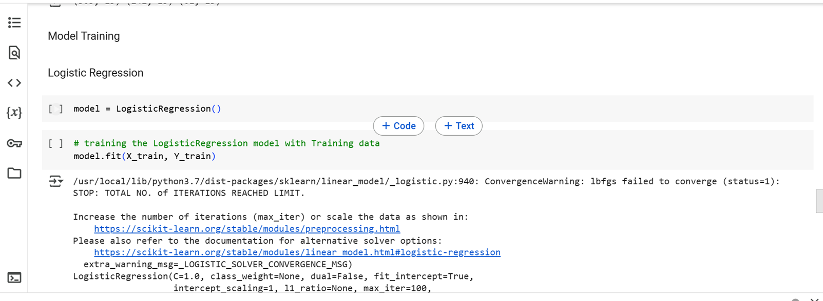
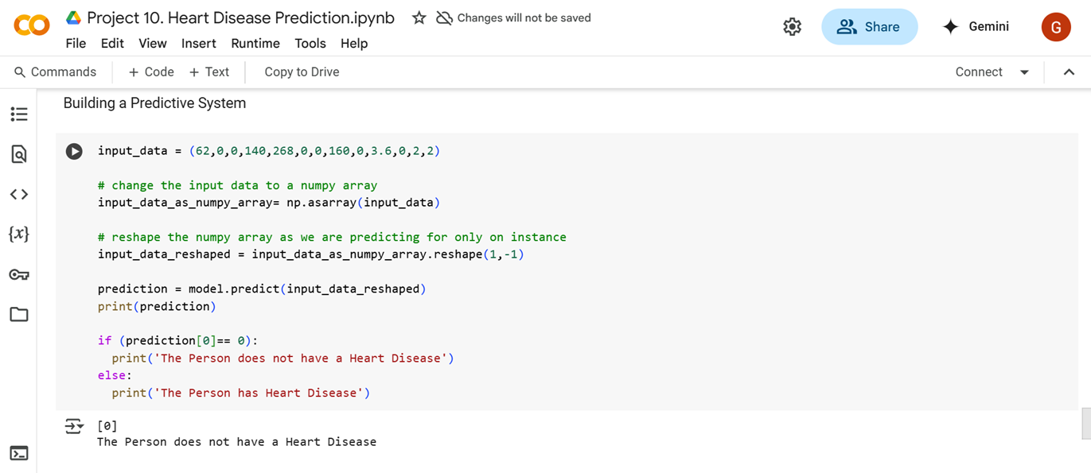
ScreenShots

Slide 5
Individual Contribution to the Project
Team Member’s | Contribution
Vinay Kumar K | Machine Learning Algorithm
G Kaushik | Machine Learning Algorithm
C Manoj Kumar | Data Analyst
Sharana Basava Mali patil | Train/Test
G Vishal Kumar Swamy | Train/test

